Slide 1
Classes
Lecture # 15
Runtime Polymorphism

Slide 2
Runtime Polymorphism
This type of polymorphism is achieved by Function Overriding using virtual functions.
This is also known as dynamic, runtime (or late) binding.

Slide 3
Runtime polymorphism is also known as dynamic polymorphism or late binding.
In runtime polymorphism, the function call is resolved at run time.
In contrast, to compile time or static polymorphism, the compiler deduces the object at run time and then decides which function call to bind to the object.
In C++, runtime polymorphism is implemented using method overriding.

Slide 4
Function Overriding
Function overriding cannot be done within a class.
The function is overridden in the derived class only.
Hence inheritance should be present for function overriding.
The second thing is that the function from a base class that is to be overridden should have the same signature or prototype i.e. it should have the same name, same return type and same argument list.
Notes:
Normal overriding resolved at compile time

Slide 5
Pointer to Base Class
One of the key features of class inheritance is that a pointer to a derived class is type-compatible with a pointer to its base class.
Only the members inherited from Base Class can be accessed if a pointer of base object is pointed towards derived class.
The pointers to the base class cannot access the specialized members of derived classes.

Slide 6
Virtual Members
A virtual member is a member function that can be redefined in a derived class, while preserving its calling properties through references.
The syntax for a function to become virtual is to precede its declaration with the virtual keyword.
Non-virtual members can also be redefined in derived classes.
But non-virtual members of derived classes cannot be accessed through a reference of the base class

Slide 7
Therefore, essentially, what the virtual keyword does is to allow a member of a derived class with the same name as one in the base class to be appropriately called from a pointer.
More precisely when the type of the pointer is a pointer to the base class that is pointing to an object of the derived class.
A class that declares or inherits a virtual function is called a polymorphic class.

Slide 8
In such cases where pointers and virtual functions are used, the call to the function is resolved at runtime, compiler determines the type of the object at runtime and calls the appropriate function.

Slide 9
In C++, the overridden function in derived class can also be private.
The compiler only checks the type of the object at compile time and binds the function at run time, hence it doesn’t make any difference even if the function is public or private.
Note that if a function is declared virtual in the base class, then it will be virtual in all of the derived classes.

Slide 10
Working
The virtual function is bound to the function body accurately at runtime by using the concept of the virtual table (VTABLE) and a hidden pointer called _vptr.

Slide 11
VTable
The compiler at compile time sets up one VTABLE each for a class having virtual functions as well as the classes that are derived from classes having virtual functions.
A VTABLE contains entries that are function pointers to the virtual functions that can be called by the objects of the class. There is one function pointer entry for each virtual function.
In the case of pure virtual functions, this entry is NULL. (This the reason why we cannot instantiate the abstract class).

Slide 12
_vptr
Next entity, _vptr which is called the vtable pointer is a hidden pointer that the compiler adds to the base class.
This _vptr points to the vtable of the class.
All the classes derived from this base class inherit the _vptr.
Every object of a class containing the virtual functions internally stores this _vptr and is transparent to the user.
Every call to virtual function using an object is then resolved using this _vptr.

Slide 13
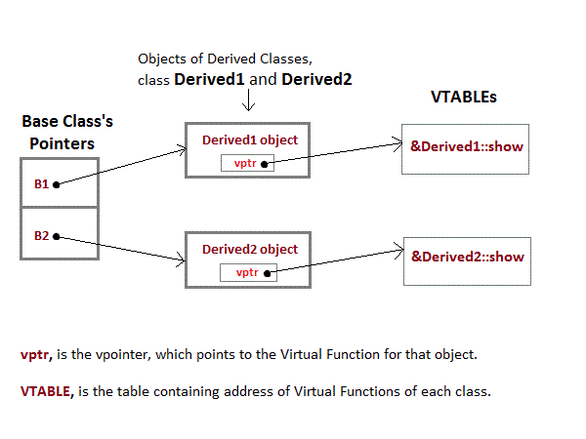

Slide 14
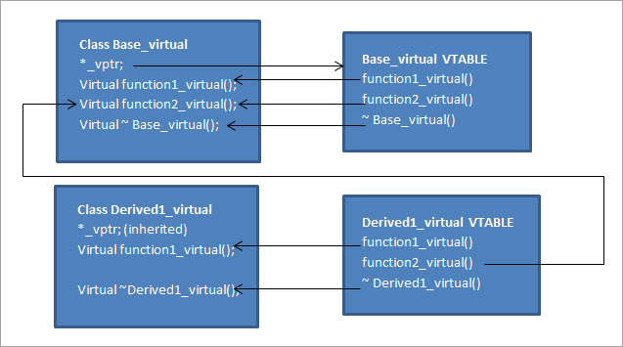

Slide 15
Pure Virtual Functions
A “pure virtual function” that is usually equated to zero.
The pure virtual function is declared as
virtual return_type function_name(arg list) = 0;

Slide 16
Abstract Class
The class which has at least one pure virtual function that is called an “abstract class”.
We can never instantiate the abstract class i.e. we cannot create an object of the abstract class.
This is because we know that an entry is made for every virtual function in the VTABLE (virtual table).
But in case of a pure virtual function, this entry is without any address thus rendering it incomplete.
So the compiler doesn’t allow creating an object for the class with incomplete VTABLE entry.
This is the reason for which we cannot instantiate an abstract class.

Slide 17
Characteristics
We cannot instantiate an abstract class.
An abstract class contains at least one pure virtual function.
Although we cannot instantiate abstract class, we can always create pointers or references to this class.
An abstract class can have some implementation like properties and methods along with pure virtual functions.
When we derive a class from the abstract class, the derived class should override all the pure virtual functions in the abstract class.
If it failed to do so, then the derived class will also be an abstract class.
It can be used to create pointers to it, and take advantage of all its polymorphic abilities.

Slide 18
Virtual Destructors
Destructors of the class can be declared as virtual.
Whenever we do upcast i.e. assigning the derived class object to a base class pointer, the ordinary destructors can produce unacceptable results.
Results in memory leaks.

Slide 19
References
https://www.geeksforgeeks.org/polymorphism-in-c/
https://www.softwaretestinghelp.com/runtime-polymorphism-in-cpp/
https://www.geeksforgeeks.org/virtual-functions-and-runtime-polymorphism-in-c-set-1-introduction/

